Slide 1
Primary Benefit Types
Value Discipline Benefits
Operating Excellence
Reduce Cost
Reduce Risk
Product Leadership
Increase Revenue
Customer Intimacy
Better Customer Experience
Enhanced Reputation
Better Lifetime Value of Customer

Slide 2
Operating Excellence Benefits - Reduce Cost
Improve operations & infrastructure
Reduce complexity & inefficiency
Conduct lump & gap analysis
Increase process & asset re-use
Integrate, consolidate & standardize process
Integrate, consolidate & standardize asset portfolios
Faster, cheaper, more reliable
operations, support & maintenance
workforce planning
project delivery
acquisitions & divestments
sourcing & procurement decisions
supply chain communications & integration
Notes:
areas that can generate cash. These might include creating innovative financing arrangements

Slide 3
Operating Excellence Benefits – Reduce Risk
Input to project planning
Reduce project size, complexity &risk
Reduce duplication across projects
Reduce conflicts between projects
Reduce implementation “surprises”
Improved requirements elicitation & validation
Structured design development & validation
Structured benefits planning & validation
Increase stakeholder buy-in
Better change management planning
Understand who is affected & who will resist
Demonstrate alignment to strategy
* Input to projects can really increase the profile of EA across the enterprise

Slide 4
Operating Excellence Benefits – Reduce Risk
Enhanced governance & risk management
Evidence basis for planning decisions
Faster, more accurate asset valuation
Prioritize effort against:
Strategic imperatives
Potential benefit / value
Solution fitness for purpose
Easier, cheaper, more accurate
threat & risk analysis
options & impact analysis
operational readiness assessment
asset life-cycle (activity & cost) planning
benefit forecasting, measurement & review
performance measurement & review
Notes:
Impact on people, process & technology
What is our direction? How do we get there? How will we know when we arrive?

Slide 5
Operating Excellence Benefits – Reduce Risk
* Better communication & discovery
“Shared message, shared journey”
Enhanced visibility of asset & initiative portfolios
Enhanced corporate memory
Supports continuous improvement / learning culture
Encourage thinking as an enterprise
Clear motivation, principles, roles & responsibilities
Better communication across enterprise (value chain)
More cross-organisational collaboration
Reference model for policy discovery
Better compliance
Better relationships with external parties
Provides a “best endeavor” legal defense
Notes:
Unless you’re a genius of staggering magnitude, your success is going to be largely dependent on your ability to work with other people.
External parties: Regulators, key partners, Customers, auditors, investors

Slide 6
Product Leadership Benefits – Increase Revenue
Better investment portfolio planning
Allows structured & ongoing review of initiatives
Supports organizational maturity modeling
Increase business impact of initiatives
Fitness for purpose assessment
Prioritization
Future state modeling
Better cross-sell & up-sell
Faster response to changes & conditions
Reduced time to market
Faster integration & leverage of new technology
Better product & service innovation
use frameworks
use structured method

Slide 7
Customer Intimacy Benefits – Improve Custexp
“providing the right information to the right people at the right time; they can make the right decision”
Integrate multi-channel experience
Easier to customize products & services
Better services & support
Easier to select most profitable channel mix
Greater technology effectiveness
More consistent communication

Slide 8
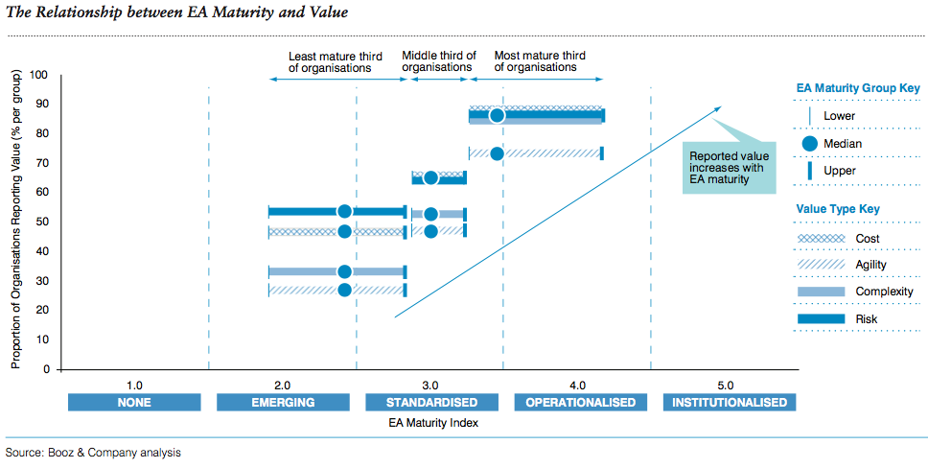
EA Benefits Life-Cycle
Cost & risk reduction first
Reduced complexity & increased agility later

